Slide 1
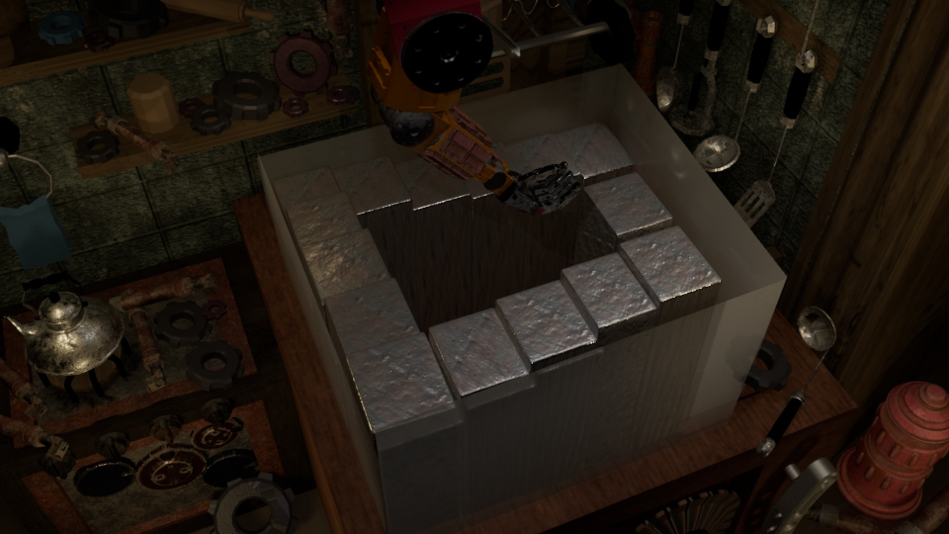
CGI TOOLS Production Support Materials Planning & Development
HE YUQIAN

Slide 2

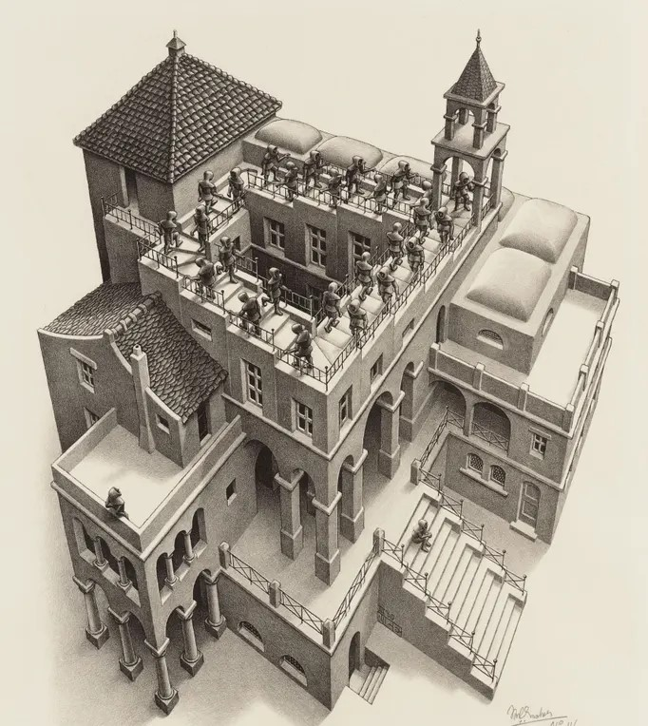
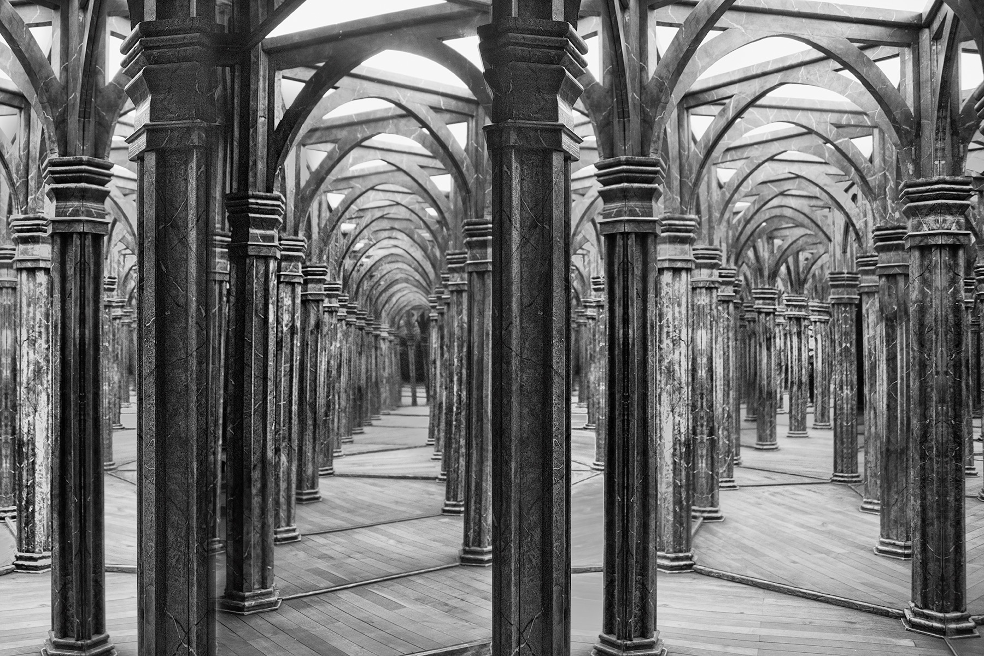
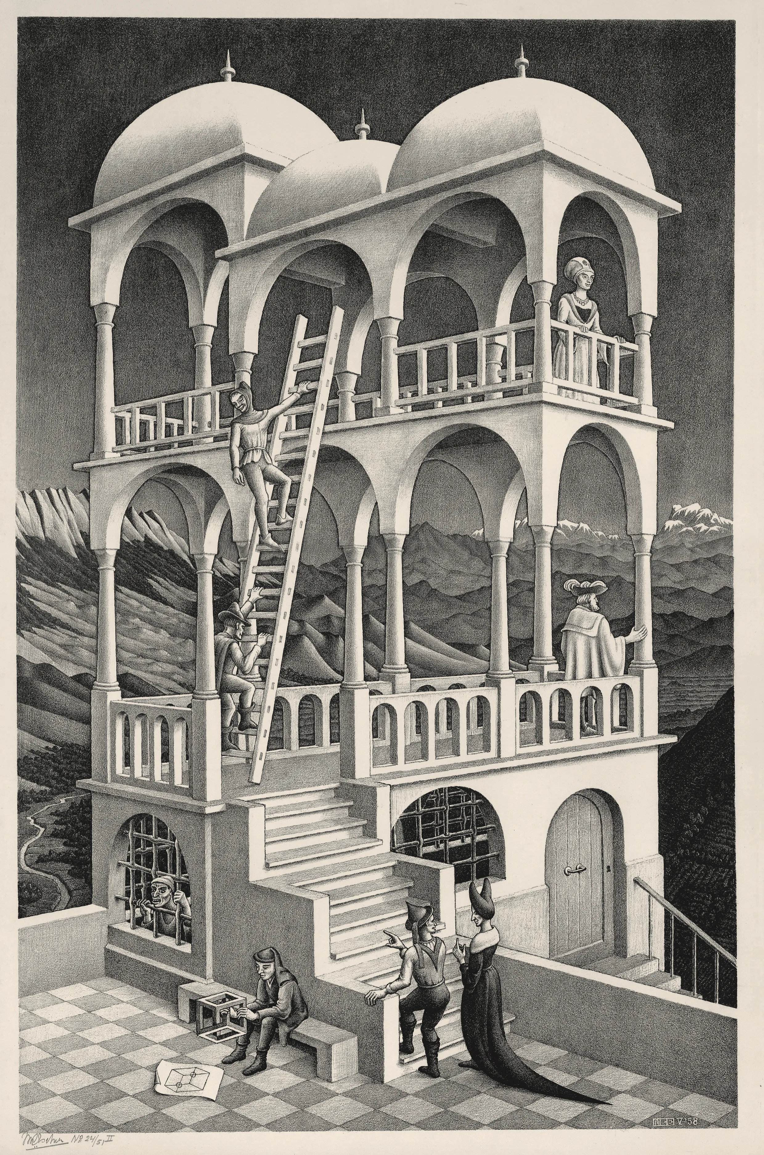
impossible staircase
An impossible staircase is a type of optical illusion that portrays a staircase that appears to violate the laws of physics due to its seemingly self-contradictory configuration. In recent years, there has been an increasing interest in the use of impossible staircases and other optical illusions as a means of artistic expression and entertainment.
Optical illusions, such as house of mirrors and 3D movies, are often featured at amusement parks and other entertainment venues as a form of entertainment. These attractions engage and stimulate the viewer's senses and are popular among amusement park goers.
Hall of Mirrors, Prague © Harold Davis
M.C. Escher, a Dutch artist, is known for using impossible staircases and other optical illusions in his art. His works have been exhibited globally and are notable for their ability to challenge the viewer's perception of reality.
M.C. Escher Works @ 2018 The M.C. Escher Company.
Ascending and Descending, 1960, by MC Escher

Slide 3
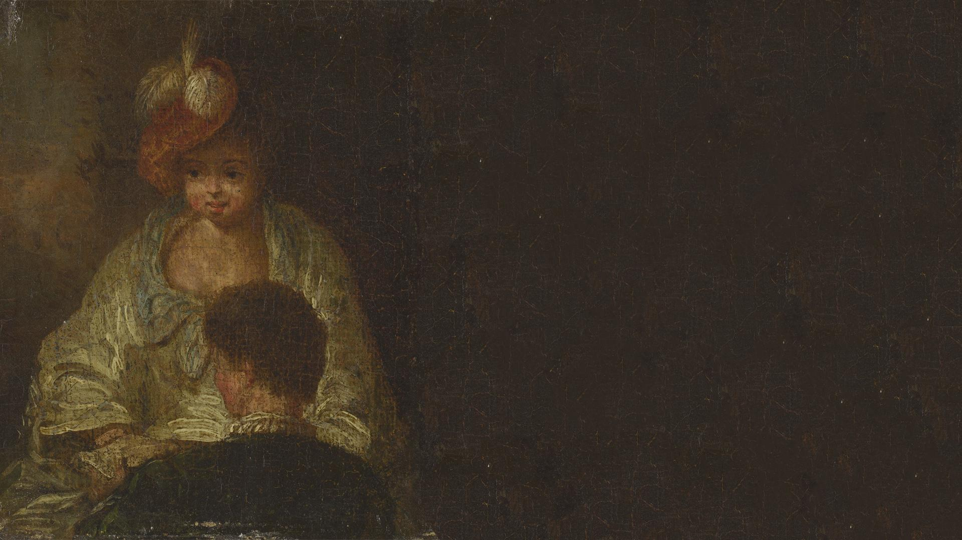
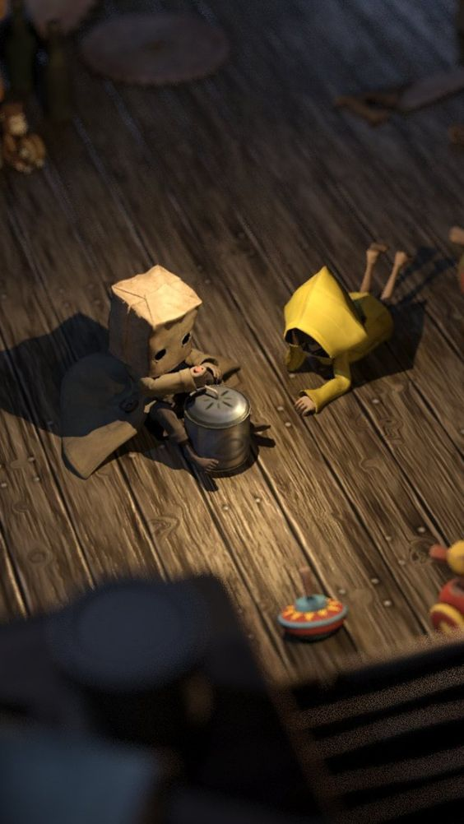
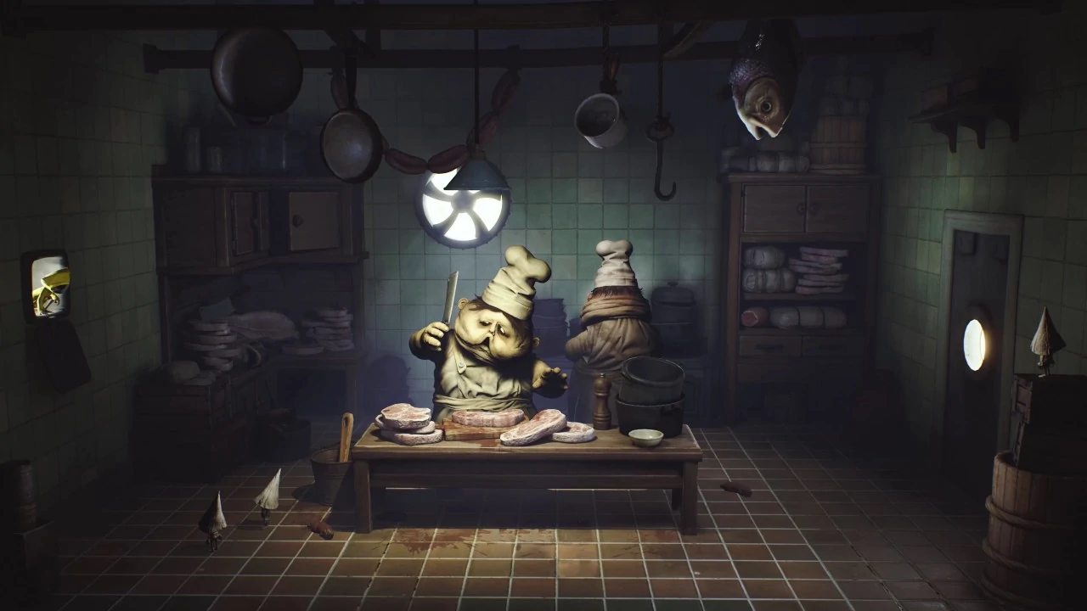
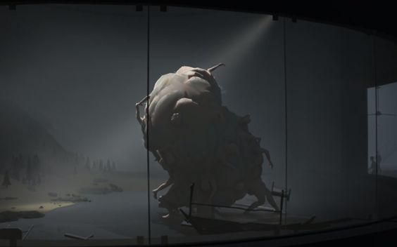
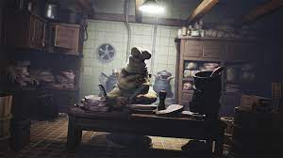
inspiration for design
The kitchen scene in Little Nightmares left a strong impression on me and served as inspiration for the creation of my own background. Specifically, I wanted to recreate the atmosphere of a dark and abandoned corner of a kitchen, complete with rotten meat and vegetables scattered across the floor and main desk.
The Huddle figures in Inside, with their minimalist, stylized design and detailed, stylized rendering, served as inspiration for the creation of my main project object, a meat ball. Specifically, I was drawn to the way that the Huddle could change shape and deform as they moved, and I used this idea to create a meat ball that would change shape in a similar way when it is rolling down the stairs.
Image of the Kitchen from the Chapter Selection menu
Screenshot of the Huddle in the game Inside
ScreenShot of the kitchen from game Little Nightmares
photo of Little Nightmares from Mono_2.

Slide 4
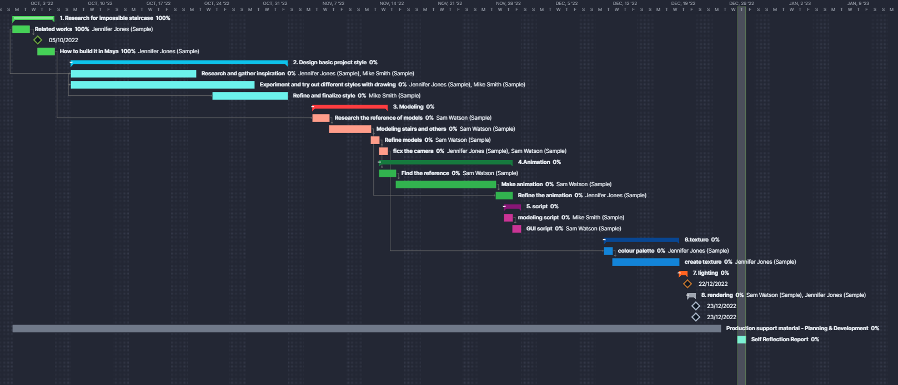
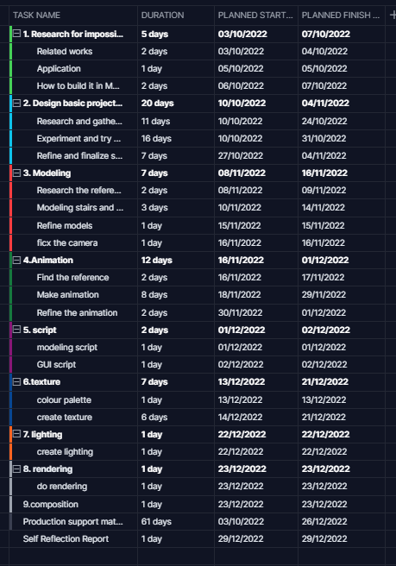
planning
Upon conceptualizing my ideas, I formulated a plan to ensure I can work on that.
My timeline which created by ProjectManager
My timeline which created by ProjectManager

Slide 5
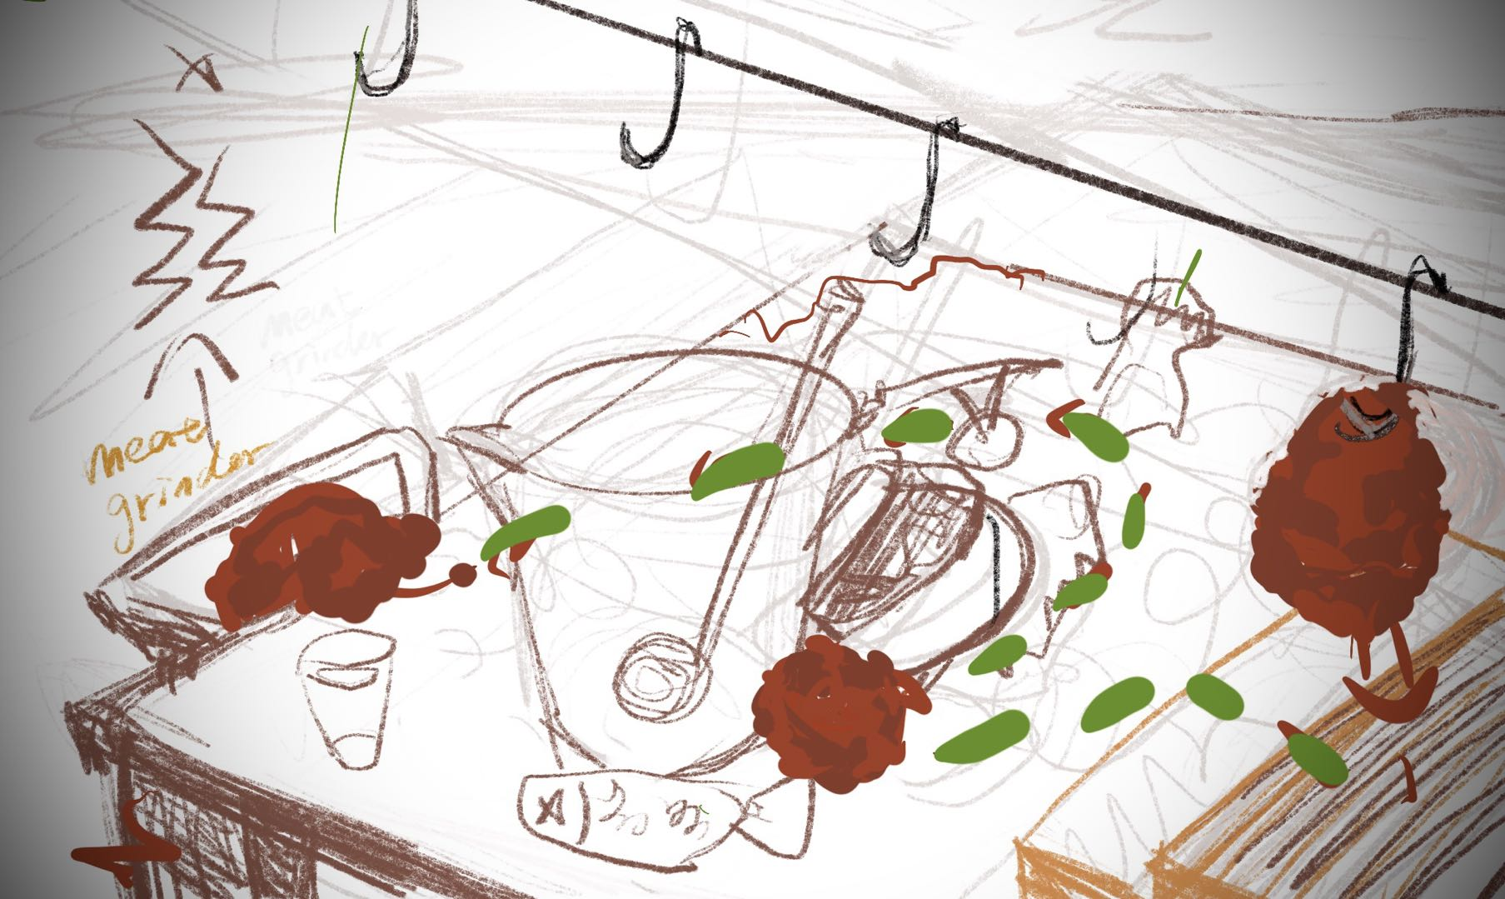


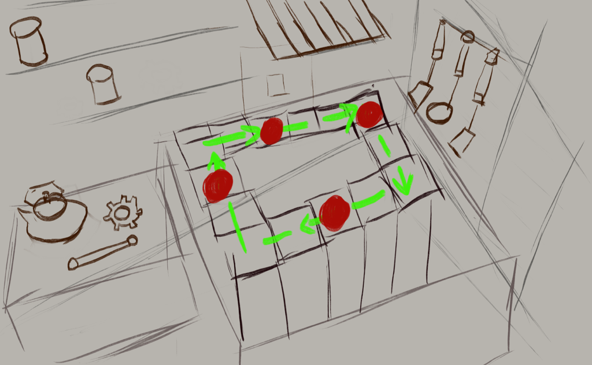
process: drawing
Background
First of all, I utilized a reference image as a guide in the creation of a draft drawing of the pieces of background layout (Figure on the left). In order to facilitate the implementation of the impossible stairs, I fixed the camera's point of view from an inclined angle above, overlooking the entire desktop. The green line in the picture indicates the possible path that the ball can roll down, and it also denotes the location where the stairs are built. The table is adorned with rotten food and very dirty tableware.
The current layout is presenting difficulties in the incorporation of the impossible stairs, as the stairs require a specific positioning in order to generate visual deviation.
I redrew the draft based on the previous failure, I first established the position of the stairs and then added other background elements. Finally, I selected a corner of a kitchen, which contained two tables: one for cooking, with a pan on the desk, and one for producing meat. This layout was chosen in order to provide a suitable environment for the rolling meat ball within the scene.

Slide 6
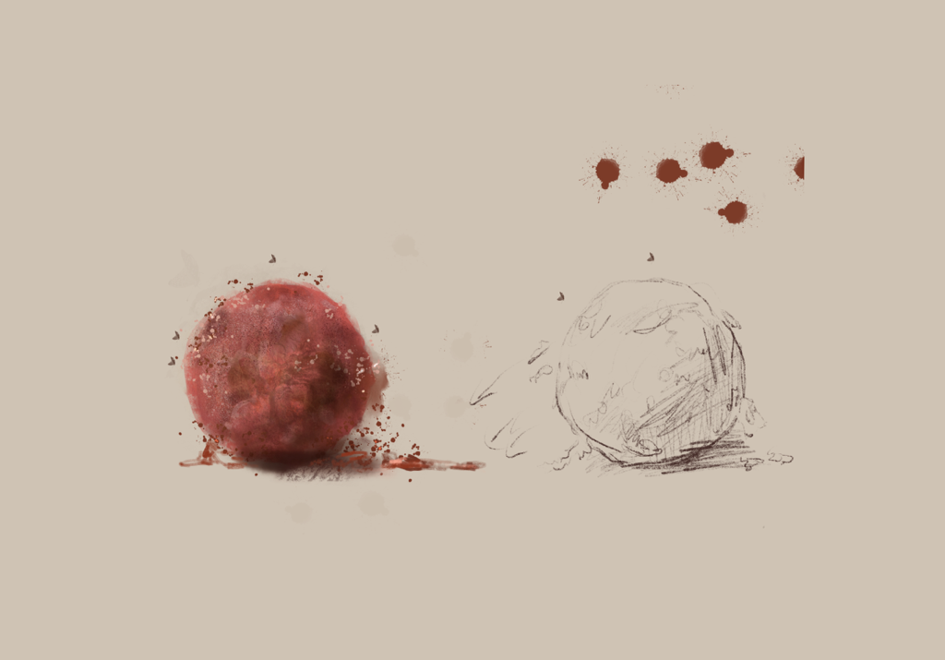
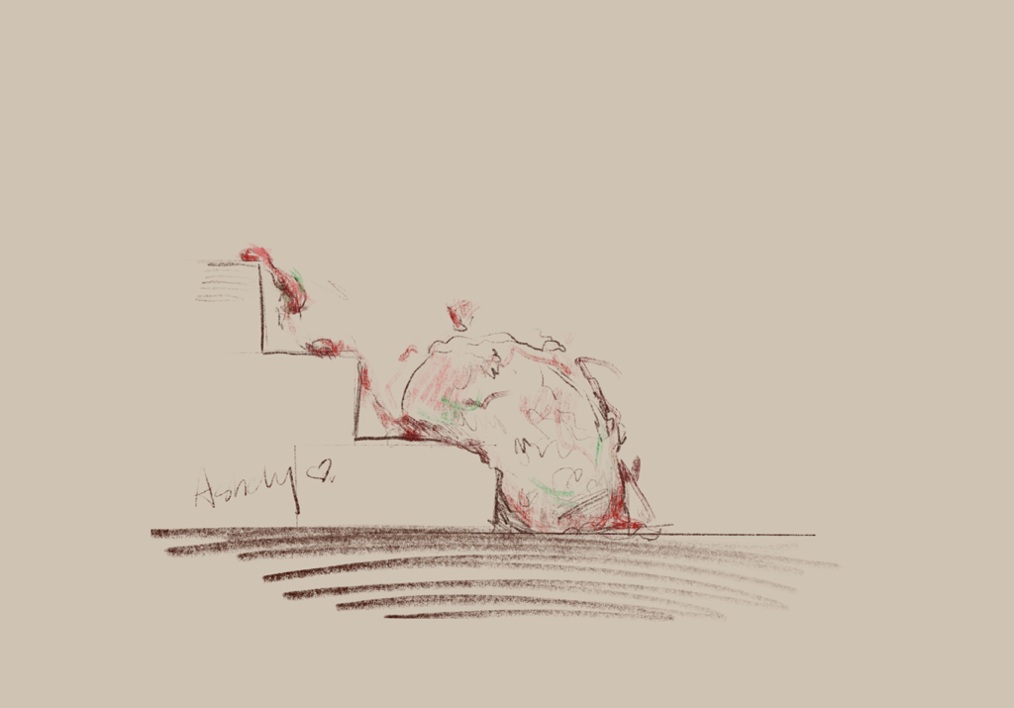
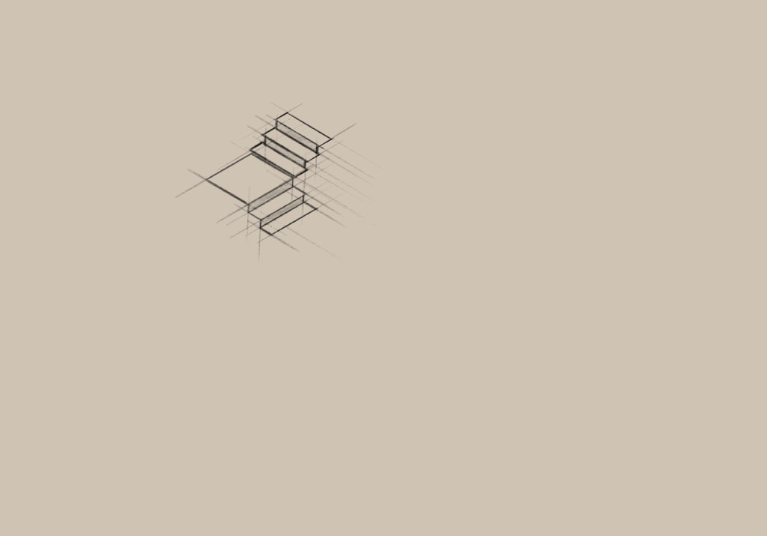
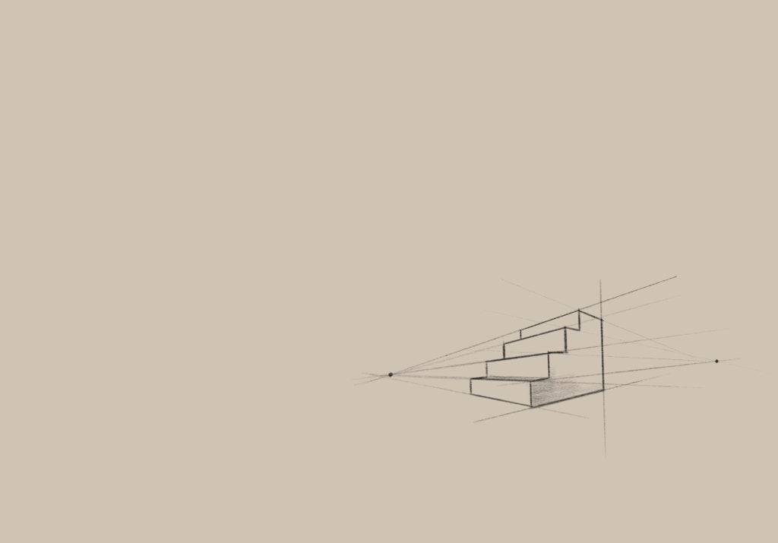
process: drawing
meat ball
I created the meat ball by using the Huddle as a reference. To increase realism, I removed the legs and arms from the reference. The left figure represents the static ball, while the right figure represents the ball rolling downstairs with its deformation.
Stairs
In order to design stairs, I drew numerous iterations of stairs with various angles in order to gain a better understanding of the design process.

Slide 7
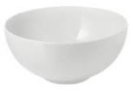
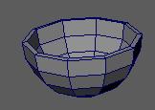
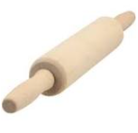
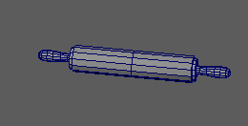
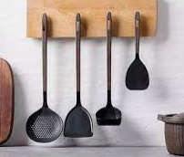
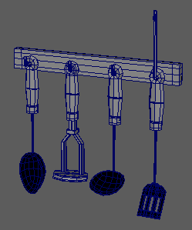
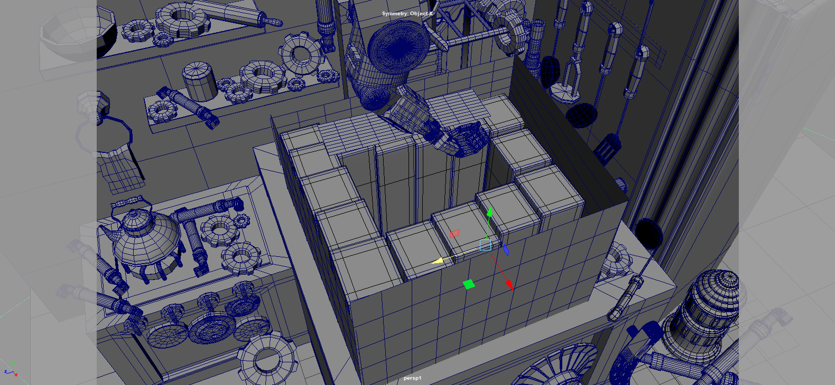
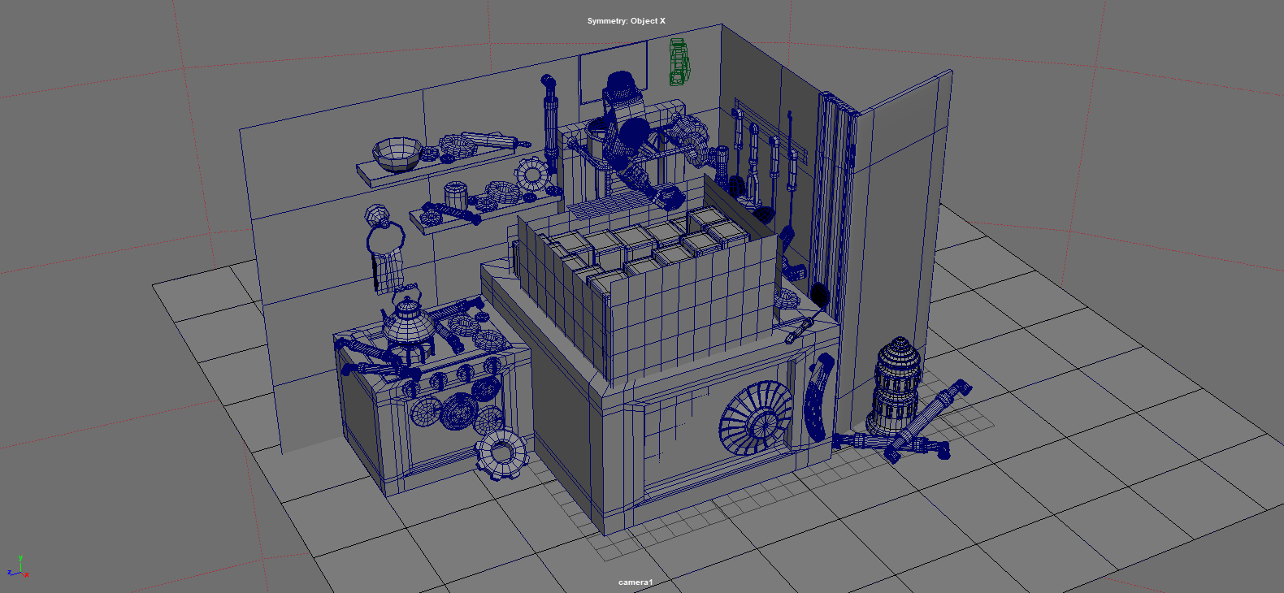

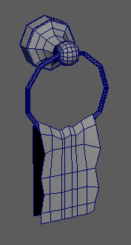

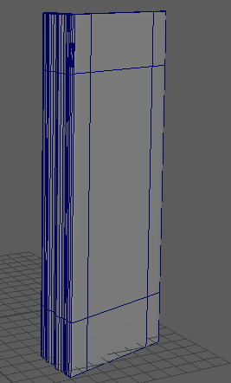
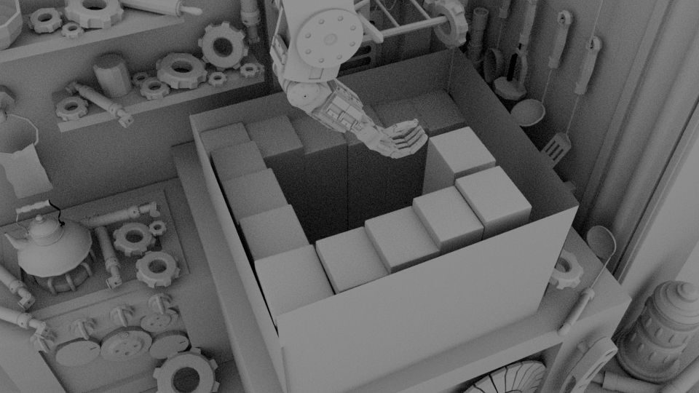
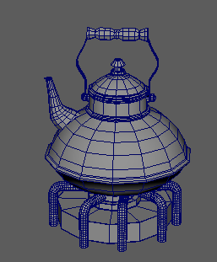
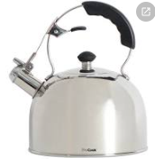
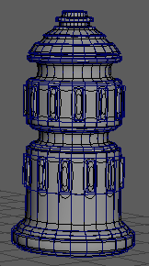

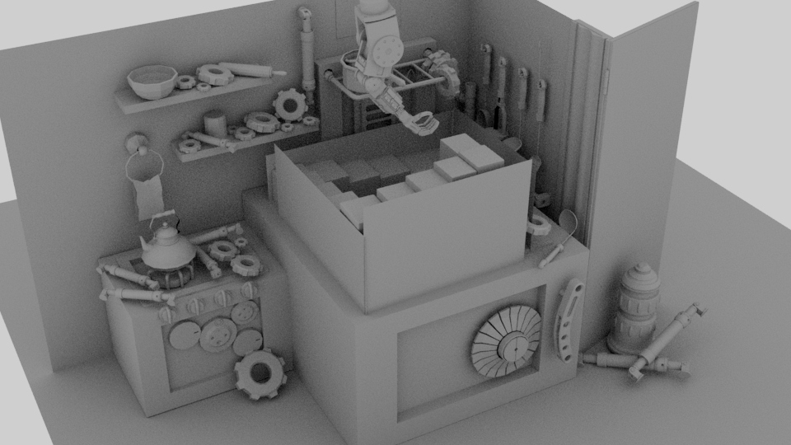
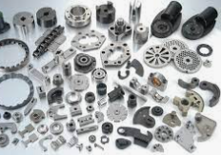
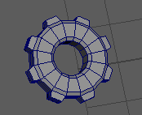
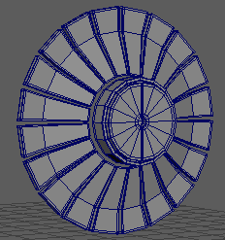
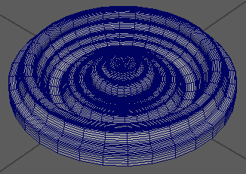
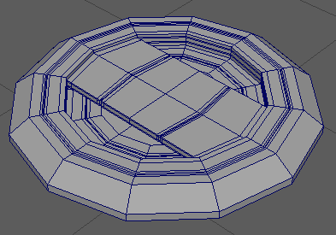
process: modeling
medel in Maya within final camera angle
white model in Maya within final camera angle
Some other objects including Robotic Arm I downloaded online: https://sketchfab.com/feed Copyright belongs to the author
white model in Maya within random camera angle

Slide 8






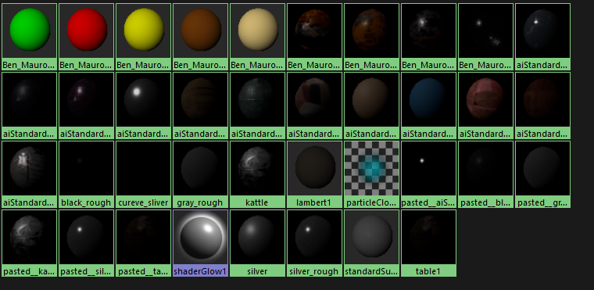
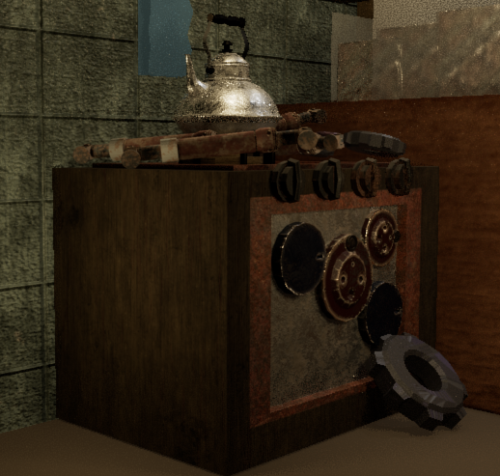
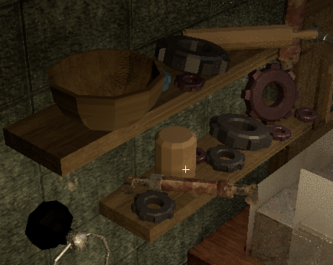
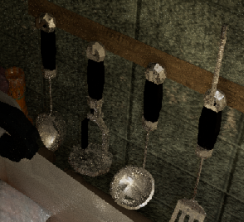
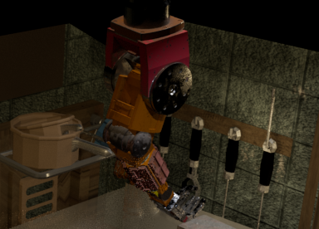
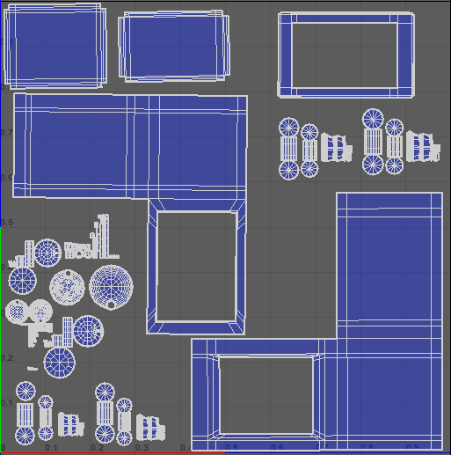
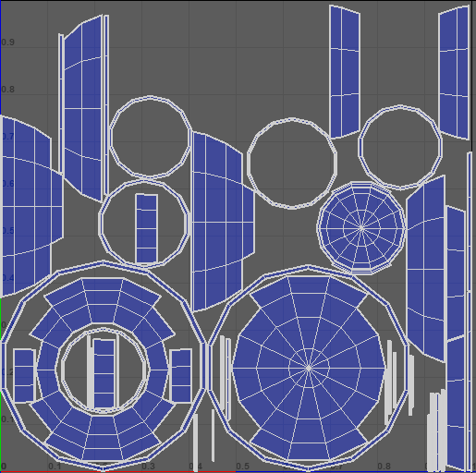
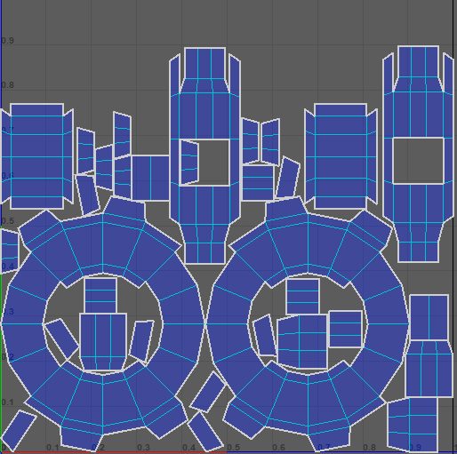
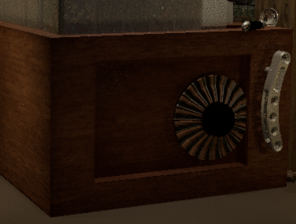
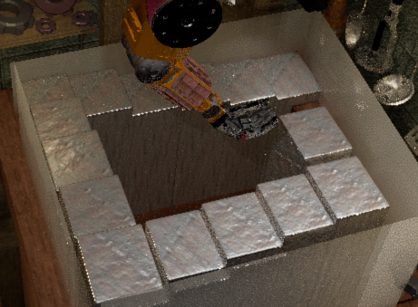
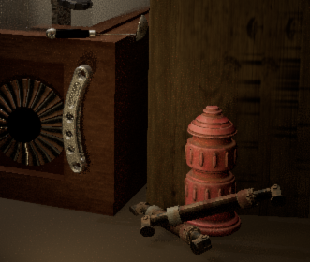
process: texture
I I selected the color palette by referencing a picture from Little Nightmares. Here is the resulting palette.
#261e15
#653523
#483121
#3b3a28
#424438
#93948d
All the textures that I created were based on the color palette and featured random rust marks. For the core object that was in close proximity to the camera, I first cut the UVs and applied texture using Substance Painter. For the other small objects, I added texture using Maya with aiStandardSurface.
The script I created in Maya scripts folder
all the materials I created in this project including ID materials
the UVs of some of the objects in this project
the render result of part of my object

Slide 9
process: animation
From the reference of the Huddle movement, first I use (create ball, try to let it move, give it a curve, follow the path, let it roll along the curve-> cannot do the deformation -> add cloth?? simulation -> cannot use the path ->add the force->to make sure the loop, will change the size due to perspective camera -> change it to orthrographic camera -> adjust the force and make sure it will rolling down the impossible stairs),

Slide 10
process: lighting
the reference give me a dark atmosphere, so all of the light I added was dark warm colour. I use ??? to add in a good position.
there is little difficult to add light on the top because the impossible stairs could not be work with the shadow. -> I closed the shadow about the stairs. but I still need the shadow of robotic arm and meat ball to make the scene more realistic. -> i used layers to seperate different object and render them seperately: robotic arm with shadow + meat ball with shadow

Slide 11
process: composition
worry about breaking the impossible stairs, I seperate them into three layers. one for background and reduce the time for rendering, just render one background. one for the robotic arm and its shadow in perspective camera, the other is meat ball with its shadow in orthrographic camera. I composite them in after effect.

Slide 12
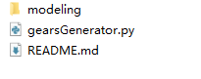
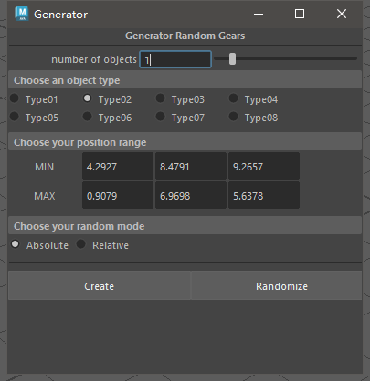







script
In order to expedite the process of generating and positioning various mechanical components, including gears, in my project. I developed a script utilizing Python. This script consists of two parts: a modeling component and a Python script component. The primary function of this script is to generate random models from a specified modeling file and randomly position them within the scene.
The script I created in Maya scripts folder
Here is some of the result I used to test my script :
Here is what I used in my Maya project :
part of my core function in script
The script interface

Slide 13
reference
Penrose Stairs (2022) Wikipedia. Wikimedia Foundation. Available at: https://en.wikipedia.org/w/index.php?title=Penrose_stairs&amp;oldid=1127296074 (Accessed: December 29, 2022). .
Escher. (2013). Gallery., Available at: https://mcescher.com/gallery/ (Accessed: December 29, 2022). .
New Hampshire Public Radio (2014, September 18). The Impossible World of M.C. Escher. Available at: https://www.nhpr.org/word-of-mouth/2014-09-18/the-impossible-world-of-m-c-escher (Accessed: December 29, 2022). .
Carroll, B. J., & Carroll, J. (2022, May 26). MC Escher:’Only Those Who Attempt the Absurd will Achieve the Impossible’ &mdash; Jim Carroll’s Blog. Available at: https://www.jimcarrollsblog.com/blog/2022/5/26/85fxsaxe7usqe5vmgqsthzm4gfzecw (Accessed: December 29, 2022). .
FISCHER . (2022, May 24). Little Nightmares Developer Teases New Game. Available at: https://comicbook.com/gaming/news/little-nightmares-tarsier-studios-new-game-tease/ (Accessed: December 29, 2022). .
Wiltshire. (2017, June 2). How Little Nightmares’ horrible characters were animated. Available at: https://www.rockpapershotgun.com/little-nightmares-creature-animations (Accessed: December 29, 2022). .
Boxer, S. (2017, April 28). Little Nightmares review: A dreamy little horror game - Pocket-lint. Available at: https://www.pocket-lint.com/games/reviews/140868-little-nightmares-review-a-dreamy-little-horror-game (Accessed: December 29, 2022). .
Vaughn, S. (2022, October 19). Will Tarsier Studios Make a “Little Nightmares III”? Fans Might Be Disappointed. Available at: https://www.distractify.com/p/will-there-be-little-nightmares-3 (Accessed: December 29, 2022). .
Bastion. (2021, July 8). Inside: Ep. 6 - The Huddle. Available at: https://www.youtube.com/watch?v=2yb3pgUSCO0 (Accessed: December 29, 2022). .
GDC (2018, January 29). Huddle up! Making the [SPOILER] of INSIDE. Available at: https://www.youtube.com/watch?v=gFkYjAKuUCE (Accessed: December 29, 2022). .
Fisk, T. (2018, November 3). Inside. Available at: https://minimediabites.com/2018/11/03/inside/ (Accessed: December 29, 2022). .
Inside ARG. (n.d.). Available at: https://wiki.gamedetectives.net/index.php?title=Inside_ARG (Accessed: December 29, 2022). .
A. (2022, July 6). How to Draw Stairs - A Guide to Creating a Realistic Staircase Drawing. 2022,Available at: https://artincontext.org/how-to-draw-stairs/ (Accessed: December 29, 2022). .
Perspective Lesson - Stairs. (n.d.). Available at: https://littleneocreative.com/perspective-lesson-stairs/ (Accessed: December 29, 2022). .
How to draw stairs in Two point perspective - basic (2018) YouTube. YouTube. Available at: https://www.youtube.com/watch?v=ysvBP0hQOPM&amp;ab_channel=BudisArch (Accessed: December 29, 2022).
(2013) YouTube. YouTube. Available at: https://www.youtube.com/watch?v=H-xd6p4Rvak&amp;ab_channel=OneMinuteMaya (Accessed: December 29, 2022).
(2021) YouTube. YouTube. Available at: https://www.youtube.com/watch?v=J7NKbiBIoMk&amp;t=452s&amp;ab_channel=MyCodeHero (Accessed: December 29, 2022).
(2022) YouTube. YouTube. Available at: https://www.youtube.com/watch?v=-ewGOE9KpZk&amp;t=5s&amp;ab_channel=ram4students (Accessed: December 29, 2022).

Slide 14
(2014) YouTube. YouTube. Available at: https://www.youtube.com/watch?v=UUceVKmKvdw&amp;t=16s&amp;ab_channel=ram4students (Accessed: December 29, 2022).
MattyRand (2021) Introduction to python for maya: 01 creating primitives, YouTube. YouTube. Available at: https://www.youtube.com/watch?v=ZydhnOD6Wbk&amp;t=20s&amp;ab_channel=MathewR (Accessed: December 29, 2022).
ScriptingSDKHowTos (2013) Introduction to python scripting in Maya - part 1: Creating and manipulating objects, YouTube. YouTube. Available at: https://www.youtube.com/watch?v=eXFGeZZbMzQ&amp;t=43s&amp;ab_channel=AutodeskScriptingandSDKLearningChannel (Accessed: December 29, 2022).
How to create window in Maya python | window create in python | create ui in Maya python | maya ui (2021) YouTube. YouTube. Available at: https://www.youtube.com/watch?v=HejBK9kAvmA&amp;ab_channel=3DKnowledge (Accessed: December 29, 2022).
MattyRand (2021) Introduction to python for maya: 05 creating a ui, YouTube. YouTube. Available at: https://www.youtube.com/watch?v=n4i4F2fmK2M&amp;t=833s&amp;ab_channel=MathewR (Accessed: December 29, 2022).
iguanazo12 (2018) Maya how to use Arnold shadow matte material, YouTube. YouTube. Available at: https://www.youtube.com/watch?v=pF9qj7MZNno&amp;t=247s&amp;ab_channel=ClaudioRamirez (Accessed: December 29, 2022).
Rendering in maya: Steps to&nbsp;render objects using the maya&nbsp;software (2021) EDUCBA. Available at: https://www.educba.com/rendering-in-maya/ (Accessed: December 29, 2022).
Render selected objects (no date) Render selected objects | Maya 2020 | Autodesk Knowledge Network. Available at: https://knowledge.autodesk.com/support/maya/learn-explore/caas/CloudHelp/cloudhelp/2020/ENU/Maya-Rendering/files/GUID-AA41A884-DB04-4174-8F17-3176E2EB5A4B-htm.html (Accessed: December 29, 2022).
Exporting objects from Autodesk maya – merge help center (no date). Available at: https://support.mergeedu.com/hc/en-us/articles/360052931292-Exporting-Objects-from-Autodesk-Maya (Accessed: December 28, 2022).

